Slide 1
Secure Data Hiding in Image Using Steganography
CAPSTONE PROJECT
Presented By:
Student Name : YASH CHAUHAN
College Name & Department : SILVER OAK UNIVERSITY (IT)

Slide 2
OUTLINE
Problem Statement
Technology used
Wow factor
End users
Result
Conclusion
Git-hub Link
Future scope

Slide 3
Problem Statement
In the digital era, securing sensitive information during communication is a challenge. Traditional encryption methods make data conspicuous, leading to potential interception. This project aims to implement steganography, a method of hiding secret data within images, making communication more secure and covert.

Slide 4
Technology used
Programming Language: Python
Libraries: OpenCV, PIL (Pillow), NumPy, Tkinter (for GUI), Cryptography (for encryption)
Image Processing: Lossless image encoding and decoding techniques

Slide 5
Wow factors
Dual-layer Security: Message encryption before embedding into an image
User-Friendly GUI: Simple interface for embedding and extracting messages
Minimal Distortion: Ensures the image remains visually unchanged after data embedding
Cross-Platform: Runs on Windows, Linux, and macOS

Slide 6
End users
Cybersecurity Professionals
Government Agencies
Private Companies (Secure Data Transfer)
General Users Concerned About Privacy

Slide 7
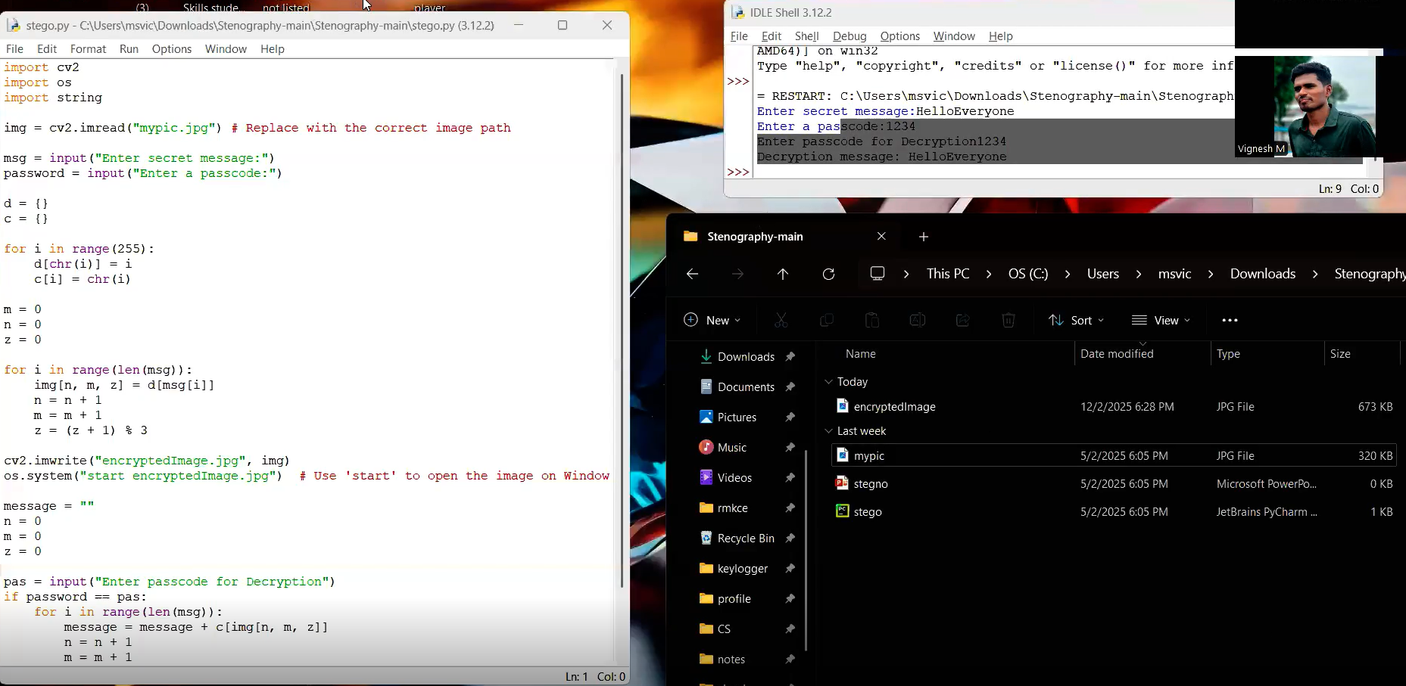
Results

Slide 8
Conclusion
Steganography provides an efficient method for covert communication by embedding secret messages within images. With encryption, the security of data transmission is enhanced, making it difficult for attackers to intercept valuable information.

Slide 9
GitHub Link
https://github.com/chouhanYash/aicte---steno-project.git

Slide 10
Future scope(optional)

Slide 11
THANK YOU

